Slide 1
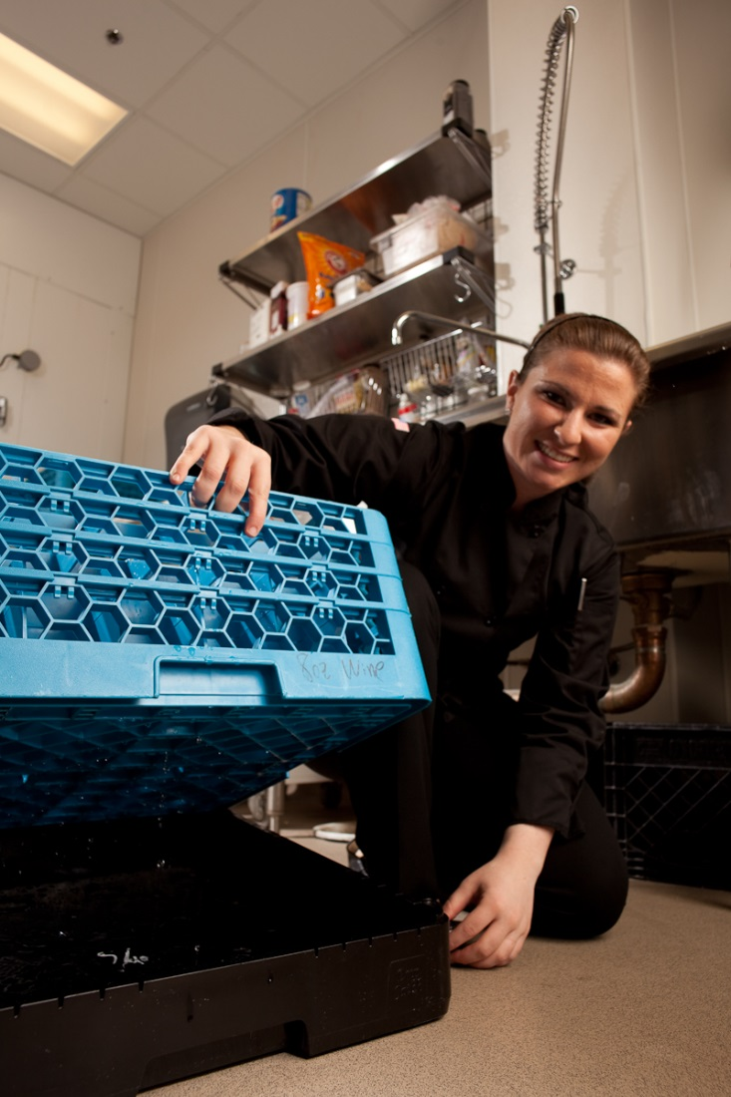
THE IMPORTANCE OF INTELLECTUAL PROPERTY
LECTURE FOUR
Charlotte Adjanor-Doku, PhD
Department of Human Resource & Organisational Development
KNUST School of Business
cadjanor-doku@knust.edu.gh

Slide 2
Lecture Objectives
Define the term “intellectual property” and describe its importance.
Explain what a patent is and describe different types of patents.
Describe a trademark and explain the process entrepreneurs use to obtain one.
Describe a copyright and identify what a copyright can protect.
Describe a trade secret and understand the common causes of trade secret disputes.

Slide 3
Lecture Objectives
Explain what an intellectual property audit is and identify the two primary reasons entrepreneurial firms should complete this type of audit

Slide 4
The Importance of Intellectual Property
Intellectual Property
Is any product of human intellect that is intangible but has value in the marketplace.
It is called “intellectual” property because it is the product of human imagination, creativity, and inventiveness.
Importance
Traditionally, businesses have thought of their physical assets, such as land, buildings, and equipment as the most important.
Increasingly, however, a company’s intellectual assets are the most important.

Slide 5
Common Mistakes Firms Make in Regard to Protecting Their Intellectual Property
Not properly identifying
all of their
intellectual property.
Not fully recognizing
the value of their
intellectual property.
Not legally protecting the
intellectual property
that needs protecting.
Not using their
intellectual property as
part of their overall
plan for success.

Slide 6
Determining What Intellectual Property to Legally Protect
Criteria 1
Criteria 2
Determine whether the intellectual property in question is directly related to the firm’s competitive advantage.
Decide whether the intellectual property in question has value in the marketplace.

Slide 7
The Four Key Forms of Intellectual Property
Patents
Trademarks
Copyrights
Trade Secrets

Slide 8
Patents
Patents
A patent is a grant from the federal government conferring the rights to exclude others from making, selling, or using an invention for the term of the patent.
There is increasing interest in patents.
Since Patent #1 was granted in 1790, the U.S. Patent & Trademark Office has granted over six million patents.
The patent office is strained. It now takes an average of 29.1 months from the date of first filing to receive a U.S. patent.

Slide 9
Patents
Patents
The Patents Act, 2003 (Act 657) (Patents Act) and the Patents Regulations 1996 (L.I. 1616) (Patents Regulations) constitute the legislative framework for the grant and protection of patents in Ghana. The Patents Office of the Registrar General's Department is the issuing office of a patent in Ghana.

Slide 10
Patents
Patents are territorial therefore a grant of a patent in Ghana affords the inventor the rights and protection of the invention only within Ghana. A patent may also be granted in respect of Ghana by filing a regional patent application with the African Regional Industrial Property Organization (ARIPO).
The World Intellectual Property Organization (WIPO) administers the Patent Corporation Treaty (PCT). The PCT ensures a unified method for filing international applications in member countries. Under the PCT, an applicant is able to file applications, conduct searches and examine inventions to determine their patentability. An applicant is then able to file an application in the national phase at the Patents Office for the grant of a patent by Ghana.

Slide 11
Proper Understanding for What a Patent Means
A patent does not give its owner the right to make, use, or sell an invention; rather, the right granted is only to exclude others from doing so.
As a result, if an inventor obtains a patent for a new kind of computer chip, and the chip would infringe on a prior patent owned by Intel, the inventor has no right to make, use, or sell the chip.
To do so, the inventor would need to obtain permission from Intel. Intel may refuse permission, or ask that a licensing fee be paid for the rights to infringe on its patent.
While this system may seem odd, it is really the only way the system could work. Many inventions are improvements on existing inventions, and the system allows the improvements to be (patented) and sold, but only with the permission of the original inventors, who usually benefit by obtaining licensing income in exchange for their consent.

Slide 12
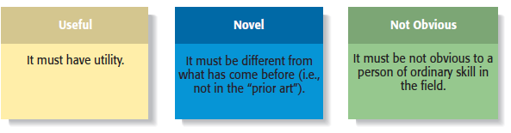
Three Basic Requirements for Obtaining a Patent

Slide 13
Types of Patents
Type
Type of Invention Covered
Duration
New or useful process, machine, manufacturer, or composition of material or any new and useful improvement thereof.
20 years from the date of the original application.
Utility
14 years from the date of the original application.
Invention of new, original, and ornamental design for manufactured products.
Design
20 years from the date of the original application.
Any new varieties of plants that can be reproduced asexually.
Plant

Slide 14
Business Method Patents (Special Utility Patent)
Business Method Patent
A business method patent is a patent that protects an invention that is or facilitates a method of doing business.
The most notable business method patents that have been awarded:
Amazon.com’s one-click ordering system.
Priceline.com’s “name-your-price” business model.
Netflix’s method for allowing customers to set up a rental list of movies to be mailed to them.

Slide 15
The Process of Obtaining a Patent

Slide 16
Patent Infringement
Patent Infringement
Takes place when one party engages in the unauthorized use of another party’s patent.
The tough part (particularly from a small entrepreneurial firm’s point of view) is that patent infringement cases are costly to litigate.
A typical patent infringement case costs each side at least $500,000 to litigate.

Slide 17
Trademarks
Trademark
A trademark is any word, name, symbol, or device used to identify the source or origin of products or services and to distinguish those product or services from others.
Trademarks also provide consumers with useful information.
For example, consumers know what to expect when they see a Macy’s store.
Think how confusing it would be if any retail store could use the name Macy’s.
Fan Milk: A well-known brand for dairy products and frozen treats like ice cream and yogurt. The "Fan Milk" name and logo are trademarked.
Kasapreko: A major player in the beverage industry, particularly known for alcoholic beverages like Alomo Bitters. The brand name "Kasapreko" and its various product logos are trademarked.
Melcom: A leading retail chain in Ghana, known for its wide range of products. The name "Melcom" and its logo are trademarked

Slide 18
The Four Types of Trademarks 1 of 2
Type
Types of Marks Covered
Duration
Any word, name, symbol, or device used to identify and distinguish one company’s goods from another.
Examples: Apple, d.light, GoPro, DripCatch, and Brain Sentry.
Renewable every 10 years, as long as the mark remains in use.
Trademark
Similar to trademarks; are used to identify the services or intangible activities of a business, rather than a business’s physical products.
Examples: 1-800-FLOWERS, Amazon.com, CoachUp, and Dropbox.
Renewable every 10 years, as long as the mark remains in use.
Service mark

Slide 19
The Four Types of Trademarks 2 of 2
Type
Types of Marks Covered
Duration
Trademarks or service marks used by the members of a cooperative, association, or other collective group.
Examples: Rotary International and International Franchise Association
Renewable every 10 years, as long as the mark remains in use.
Collective mark
Marks, words, names, symbols, or devices used by a person other than the owner to certify a particular quality about a good or service.
Examples: 100% Napa Valley and Underwriters Laboratories
Renewable every 10 years, as long as the mark remains in use.
Certification mark

Slide 20
What is Protected Under Trademark Law 1 of 2
Item
Example(s)
Words
Birchbox, Warby Parker, DripCatch
Numbers and letters
3M, Boeing 787, AT&T
Designs and logos
Nike swoosh logo
Sounds
MGM’s lion’s roar

Slide 21
What is Protected Under Trademark Law 2 of 2
Item
Example
Fragrances
Stationery treated with a special fragrance
Shapes
Unique shape of the Apple iPhone
Colors
Nexium—the “purple pill”
Trade dress
The layout and décor of a restaurant

Slide 22
Exclusions From Trademark Protection
Item
Example
Immoral or scandalous matter
Profane words
Labeling oranges “Fresh Florida Oranges” that aren’t grown in Florida
Deceptive matter
Phrases like “golf ball” and “fried chicken” are descriptive and can’t be trademarked
Descriptive marks
Common surnames like “Anderson” or “Smith” can’t be trademarked
Surnames

Slide 23
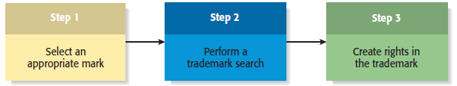
The Process of Obtaining a Trademark

Slide 24
Trademark Registration in Ghana
1. PRELIMINARY SEARCH (OPTIONAL)
A trade mark search may be conducted prior to the application for registration of the trade mark. The search is important to ensure that no identical trademark has been registered or is pending registration..
2. APPLICATION FOR TRADE MARK REGISTRARTION
Trade Mark Form No. 2 is used for the application of the trade mark. An applicant is required to attach four (4) representations of the trade mark with a prescribed fee of $ 200.0 or its Ghana Cedi equivalent. Applicants whose principal place of business is located outside Ghana are required to apply through a legal entity.
3. REVIEW/EXAMINATION OF TM. No 2 BY THE TRADE MARKS OFFICE
Section 1, Section 3, Subsection (1) and (2) of Section 4, and Section 5 of the Trade Marks Act, 2004, Act 664

Slide 25
Trademark Registration in Ghana
4. PUBLICATION AND OPPOSITION OF TRADEMARK
All trade mark applications accepted by the registrar are published in the Industrial Trade Marks Bulletin (Journal) for a period of two (2) months. Within this period, any interested party or person may file a notice of opposition to the registration in the prescribed manner
5. CERTIFICATION OF TRADEMARK
In the event where there is no opposition to the approved trademarks, the proprietor of a trademark requests the issuance of his trade mark certificate. A certificate of registration of the trademark is then issued to the applicant, and the registered trademark is valid for a period of 10 years from the filing date of the application..

Slide 26
Trademark Registration in Ghana
6. RENEWAL OF TRADE MARKS
Renewals of trademarks are made every ten (10) years
NB: Non-use for 5 years following registration makes the registration vulnerable to cancellation
SCHEDULE OF TRADE MARK FEES
TRADE MARK SEARCH : $ 135.00
TRADE MARK APPLICATON : $ 240.00
CERTIFICATION OF TRADE MARK : $ 240.00

Slide 27
Copyrights
Copyrights
A copyright is a form of intellectual property protection that grants to the owner of a work of authorship the legal right to determine how the work is used and to obtain the economic benefits from the work.
A work does not have to have artistic merit to be eligible for copyright protection.
As a result, things such as operating manuals and sales brochures are eligible for copyright protection.

Slide 28
What is Protected By a Copyright?
Literary works
Musical compositions
Computer software
Dramatic works
Pantomimes and
choreographic works
Pictorial, graphic, and
sculptural works

Slide 29
Exclusions From Copyright Protection
The Idea-Expression Dichotomy
The main exclusion is that copyright laws cannot protect ideas.
For example, an entrepreneur may have the idea to open a soccer-themed restaurant. The idea itself is not eligible for copyright protection. However, if the entrepreneur writes down specifically what his or her soccer-themed restaurant will look like and how it will operate, that description is copyrightable.
The legal principle describing this concept is called the idea-expression dichotomy.
An idea is not copyrightable, but the specific expression of an idea is.

Slide 30
Obtaining a copyright in Ghana Step One
Prepare and Submit the Application.
Indicate:
the name and citizenship of the author and/or main performers;
the title of the work;
the year the original work was produced; and
the date and place of first publication (if applicable). The application shall also include the payment of the current application fee.
If the work to be registered has been published, the applicant must deposit two copies of the work with the application; if the work has not been published, the applicant only deposits one copy.
Applicants registering sound and audio-visual works must deposit two copies of the phonograms and any printed or perceptible material published with the work, irrespective of its publication status.
For collective works appearing in newspapers or periodicals (within a 12-month period), one copy of the entire newspaper or periodical, or the applicable section thereof, must be filed with the application.
In certain situations, a photograph or illustration may be submitted in lieu of a true copy.

Slide 31
Obtaining a copyright in Ghana Step Two
Registration of Copyright and Issue of Certificate On receipt of the application for registration of copyright or related right (such as derivative works or adaptations), the fee and the deposit of the work, the Copyright Office shall, within two weeks after their receipt, determine whether the work is a subject matter for registration or not and in writing inform the applicant accordingly. Where the Copyright Office determines that a deposited work is a subject matter for registration, the Copyright Office shall issue a certificate of registration of copyright or related right to the applicant within two weeks after informing the applicant that the work is a subject matter for registration.

Slide 32
Copyright Infringement 1 of 2
Copyright Infringement
Copyright infringement occurs when one work derives from another or is an exact copy or shows substantial similarity to the original work.
To prove infringement, a copyright owner is required to show that the alleged infringer had prior access to the copyrighted work and that the work is substantially similar to the owner’s.

Slide 33
Copyright Infringement 2 of 2
The illegal downloading of
music is an example of
copyright infringement.
Copyright infringement costs
the owners of copyrighted
material an estimated $25
billion per year in the U.S.
alone.

Slide 34
Trade Secrets
Trade Secrets
A trade secret is any formula, pattern, physical device, idea, process, or other information that provides the owner of the information with a competitive advantage in the marketplace.
Trade secrets include marketing plans, product formulas, financial forecasts, employee rosters, logs of sales calls, and similar types of proprietary information.
The Federal Economic Espionage Act, passed in 1996, criminalizes the theft of trade secrets.

Slide 35
What Qualifies for Trade Secret Protection? 1 of 2
Trade Secret Protection
Not all information qualifies for trade secret protection.
In general, information that is know to the public or that competitors can discover through legal means doesn’t qualify for trade secret protection.
Companies protect trade secrets through physical measures and written documents.

Slide 36
What Qualifies for Trade Secret Protection? 2 of 2
The strongest case for trade secret protection is information that is characterized by the following.
Is not known outside the company.
Is known only inside the company on a “need-to-know” basis.
Is safeguarded by stringent efforts to keep the information
confidential.
Is valuable and provides the company a competitive advantage.
Was developed at great cost, time, and effort.
Cannot be easily duplicated, reverse engineered, or discovered.

Slide 37
Physical Measures for Protecting Trade Secrets
Restricting access
Labeling documents
Password protecting
confidential computer
files
Maintaining logbooks
for visitors
Maintaining logbooks for
access to sensitive
material
Maintaining adequate
overall security
measures

Slide 38
Conducting an Intellectual Property Audit 1 of 2
Intellectual Property Audit
The first step a firm should take to protect its intellectual property is to complete an intellectual property audit.
An intellectual property audit is conducted to determine the intellectual property a firm owns.
There are two reasons for conducting an intellectual property audit:
First, it is prudent for a company to periodically determine whether its intellectual property is being properly protected.
Second, it is important for a firm to remain prepared to justify its valuation in the event of a merger or acquisition.

Slide 39
Conducting an Intellectual Property Audit 2 of 2
The Process of Conducting an Intellectual Property Audit
The first step is to develop an inventory of a firm’s existing intellectual property. The inventory should include the firm’s present registrations of patents, trademarks, and copyrights.
The second step is to identify works in progress to ensure that they are being documented and protected in a systematic, orderly manner.

Slide 40

ANY QUESTION?

Slide 41
THANK YOU

